Slide 1
Objectives
FAT disks
Drive slack, file slack and RAM slack
Explain the structure of NTFS disks

Slide 2
Announcements
Collecting all the labs 5 and 6
Wednesday – meeting in Rickover 006
Friday – mid-project presentation (graded)
12mins presentation:
What your project is about
What has been done so far
Your next steps
PPT presentation

Slide 3
Exploring Microsoft File Structures
In Microsoft file structures, sectors are grouped to form clusters
Storage allocation units of one or more sectors
Clusters range from 512 bytes up to 32,000 bytes each
Combining sectors minimizes the overhead of writing or reading files to a disk

Slide 4
Examining FAT Disks
File Allocation Table (FAT)
File structure database that Microsoft originally designed for floppy disks
FAT database is typically written to a disk’s outermost track and contains:
Filenames, directory names, date and time stamps, the starting cluster number, and file attributes
Cluster sizes vary according to the hard disk size and file system

Slide 5
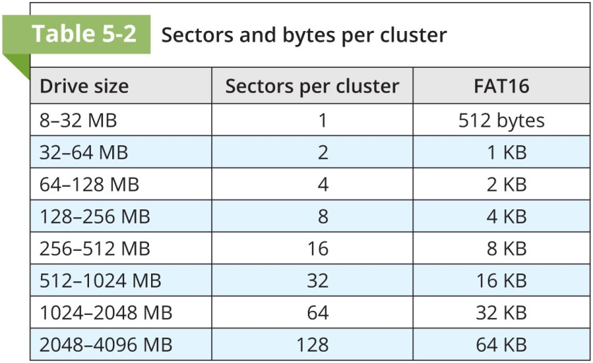
Examining FAT Disks

Slide 6
More on slack space
Microsoft OSs allocate disk space for files by clusters
Results in drive slack
Unused space in a cluster between the end of an active file’s content and the end of the cluster
Drive slack includes:
RAM slack + file slack

Slide 7
Scenario
Suppose you create a text document containing 5000 characters (how many bytes?) and disk size is FAT16 1.6GB disk.
How many sectors per cluster?
What is the cluster size?
How many sectors are allocated for the file?
How much of the last sector is not used? (RAM slack)
How much of the cluster is unused? (file slack)
How much is the portion of the unused sector? How big is that?

Slide 8
Slack space
DOS must write in full 512-byte chunks of data (sectors).
The data to fill the 120-byte void is pulled from RAM and placed in the area between the end of the file (EOF)
Logon IDs or passwords,
Deleted e-mails, and passwords

Slide 9
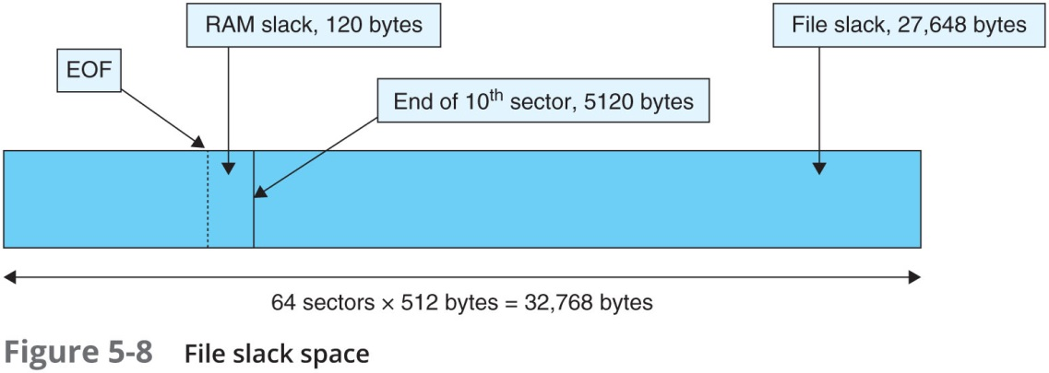
Examining FAT Disks

Slide 10
Examining FAT Disks
When this first assigned cluster is filled and runs out of room
FAT assigns the next available cluster to the file
If the next available cluster isn’t contiguous to the current cluster
File becomes fragmented

Slide 11
NTFS Disks
NT File System (New Technology File System)
Introduced with Windows NT
Primary file system for Windows 10
Improvements over FAT file systems
NTFS provides more information about a file
NTFS gives more control over files and folders
NTFS was Microsoft’s move toward a journaling file system

Slide 12
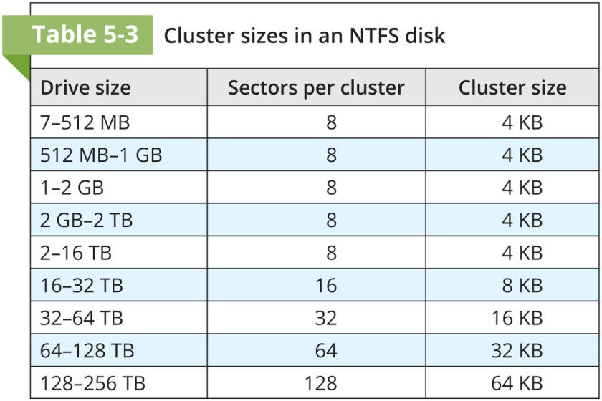
Examining NTFS Disks

Slide 13
NTFS Disks
In NTFS, everything written to the disk is considered a file
On an NTFS disk
First data set is the Partition Boot Sector
Next is Master File Table (MFT)
NTFS results in much less file slack space
Clusters are smaller for smaller disk drives

Slide 14

NTFS partition

Slide 15
NTFS System Files
MFT is a database in which information abut every file and directory on the disk
Including the system files the OS uses
In the MFT, the first 15 records are reserved for system files
Records in the MFT are called metadata

Slide 16
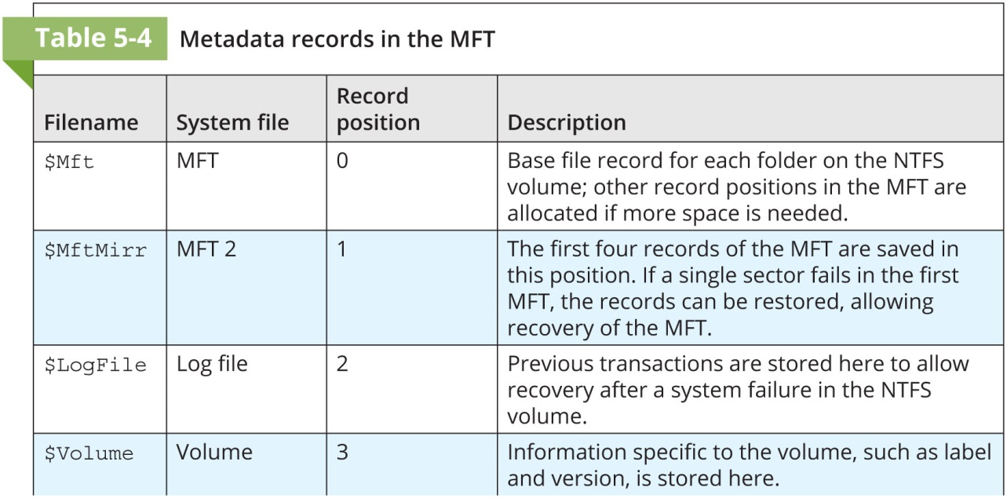
NTFS File System

Slide 17
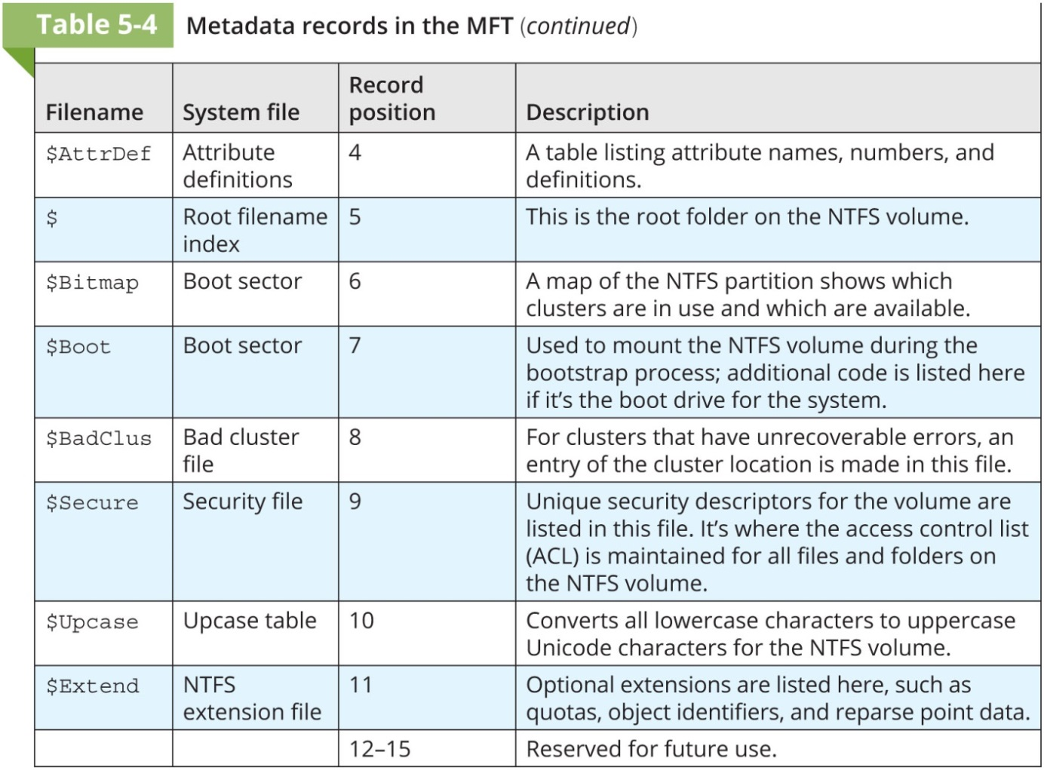
NTFS File System

Slide 18
MFT and File Attributes
In the NTFS MFT
All files and folders are stored in separate records of 1024 bytes each
Each record contains file or folder information
This information is divided into record fields containing metadata
A record field is referred to as an attribute ID
File or folder information is typically stored in one of two ways in an MFT record:
Resident and nonresident

Slide 19
MFT and File Attributes
Files larger than 512 bytes are stored outside the MFT
MFT record provides cluster addresses where the file is stored on the drive’s partition
Referred to as data runs
Each MFT record starts with a header identifying it as a resident or nonresident attribute

Slide 20
Master Table File Records
In the NTFS MFT
All files and folders are stored in separate records of 1024 bytes each
Each file or directory has at least one record in MFT.
MFT entry header is 42 bytes

Slide 21
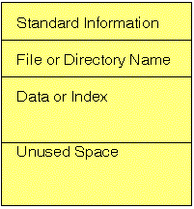
MFT record for a small file
Small files are completely contained in an MFT record. An MFT entry is very much like a database record with many optional fields.

Slide 22
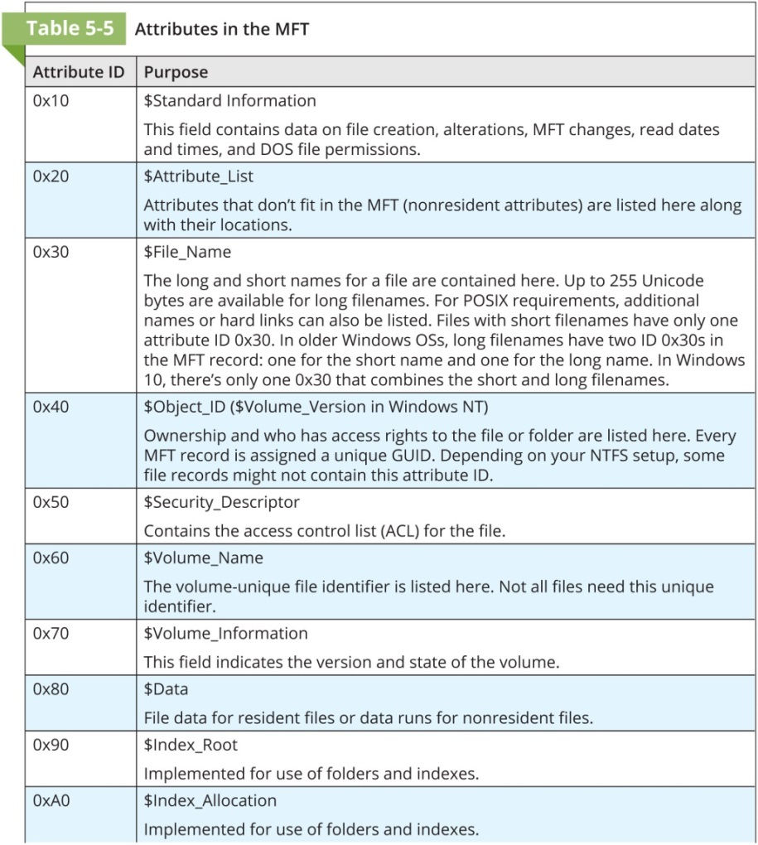
MFT and File Attributes

Slide 23
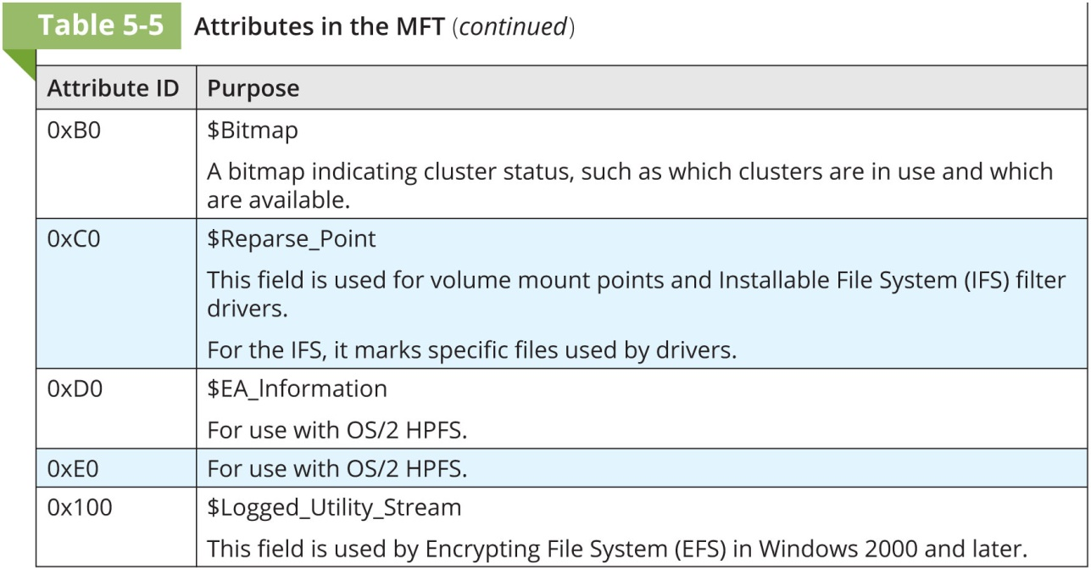
MFT and File Attributes

Slide 24
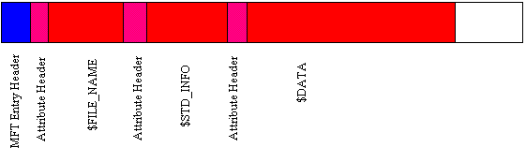
MFT record structure example

Slide 25
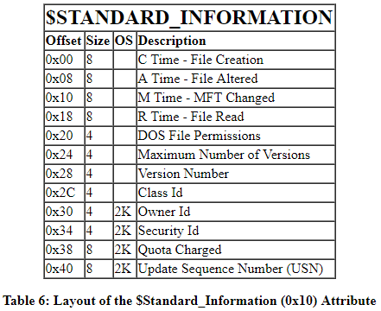
$Standard information

Slide 26
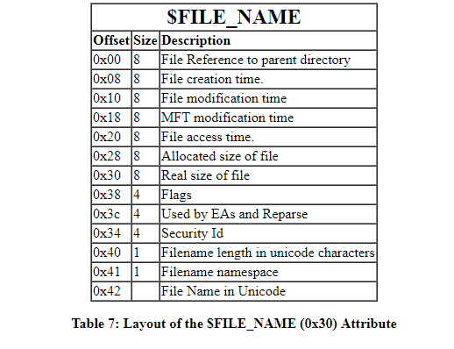
$ Filename attribute

Slide 27
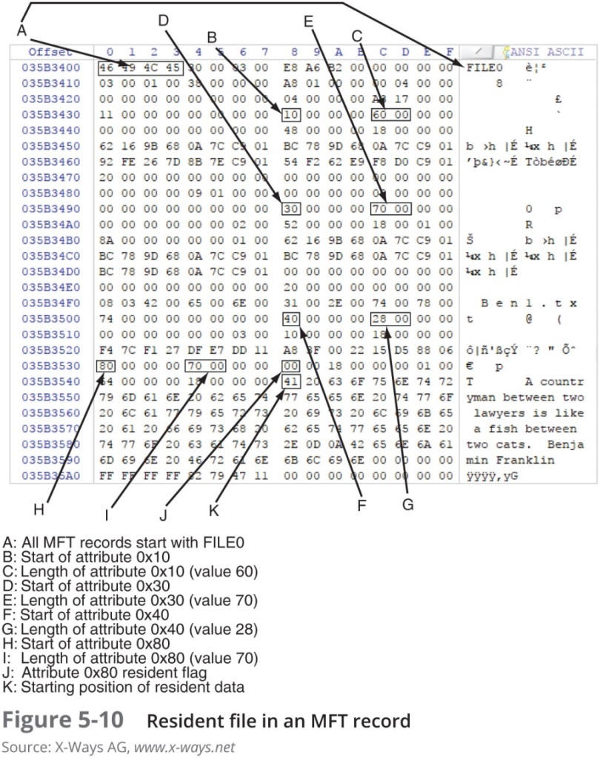
MFT and File Attributes

Slide 28
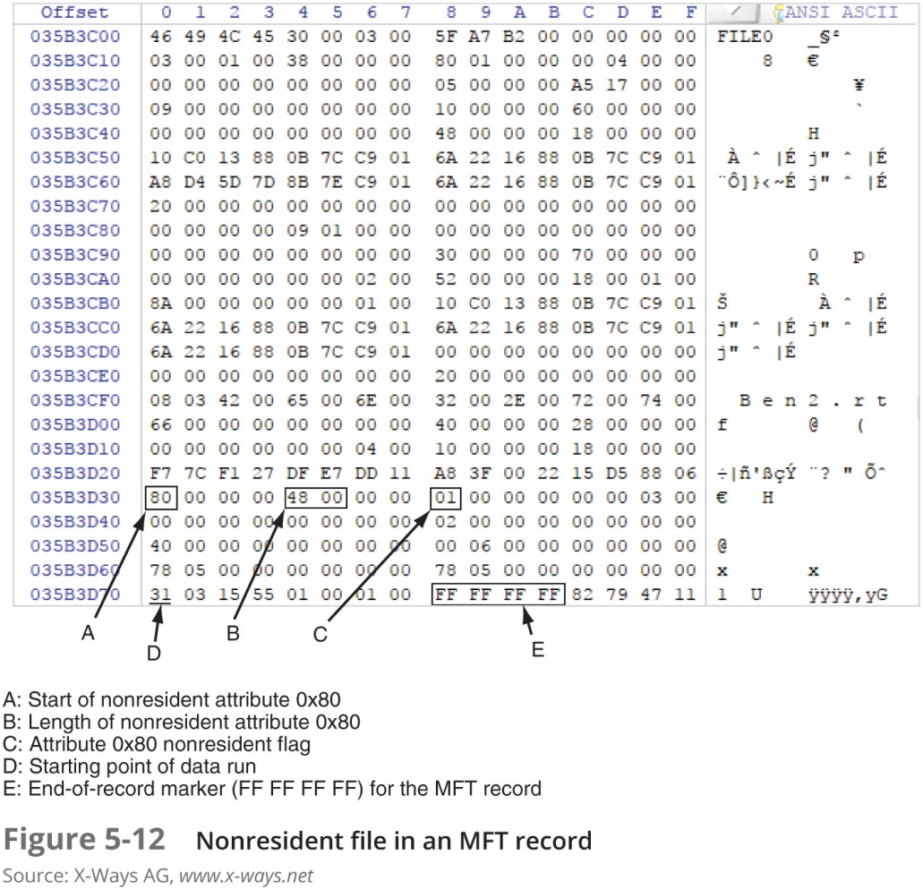
MFT and File Attributes

